Slide 1
🧩 MySQL Constraints

Slide 2
Constraints are rules applied to table columns in MySQL to ensure data accuracy, reliability, and consistency in the database.
They limit the type of data that can go into a table and enforce business rules automatically.

Slide 3
⚙️ 1️⃣ Why Constraints Are Important
Prevent invalid or inconsistent data.
Enforce relationships between tables.
Maintain data integrity (the correctness and completeness of data).
Reduce the need for manual validation in application code.

Slide 4
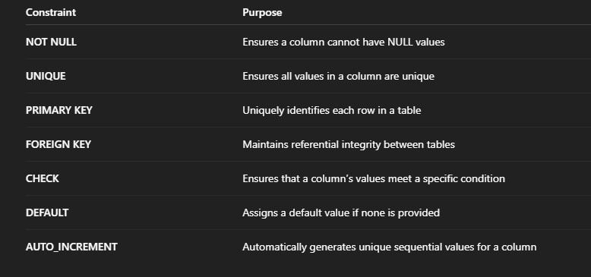
📘 2️⃣ Types of Constraints in MySQL

Slide 5
✅ (a) NOT NULL Constraint
Ensures that a column must have a value.
CREATE TABLE Employee (
emp_id INT NOT NULL,
name VARCHAR(50) NOT NULL,
department VARCHAR(50)
);
➡️ You cannot insert a record without emp_id or name.
Maintains referential integrity between two tables. It ensures that a value in one table exists in another related table.

Slide 6
✅ (b) UNIQUE Constraint
Ensures that all values in a column are distinct.
CREATE TABLE Student (
student_id INT PRIMARY KEY,
email VARCHAR(100) UNIQUE
);
➡️ Two students cannot have the same email address.

Slide 7
✅ (c) PRIMARY KEY Constraint
Uniquely identifies each row in a table. It automatically implies NOT NULL + UNIQUE.
CREATE TABLE Department (
dept_id INT PRIMARY KEY,
dept_name VARCHAR(50) NOT NULL
);

Slide 8
✅ (d) FOREIGN KEY Constraint
Maintains referential integrity between two tables. It ensures that a value in one table exists in another related table.
CREATE TABLE Employee (
emp_id INT PRIMARY KEY,
name VARCHAR(50),
dept_id INT,
FOREIGN KEY (dept_id) REFERENCES Department(dept_id)
);
➡️ You cannot assign an employee to a department that doesn’t exist.

Slide 9
✅ (e) CHECK Constraint
Ensures that column values meet specific conditions.
CREATE TABLE Account (
acc_id INT PRIMARY KEY,
balance DECIMAL(10,2) CHECK (balance >= 0)
);
➡️ Negative balance values are not allowed.

Slide 10
✅ (f) DEFAULT Constraint
Assigns a default value to a column if no value is provided during insertion.
CREATE TABLE Orders (
order_id INT PRIMARY KEY,
status VARCHAR(20) DEFAULT 'Pending'
);
➡️ If no status is given, it automatically becomes 'Pending'.

Slide 11
✅ (g) AUTO_INCREMENT
Automatically generates unique sequential numbers (often used with PRIMARY KEY).
CREATE TABLE Products (
product_id INT AUTO_INCREMENT PRIMARY KEY,
name VARCHAR(50)
);
➡️ product_id automatically increases for each new record.

Slide 12
🔐 4️⃣ Combining Multiple Constraints
CREATE TABLE Employee (
emp_id INT AUTO_INCREMENT PRIMARY KEY,
name VARCHAR(50) NOT NULL,
email VARCHAR(100) UNIQUE,
salary DECIMAL(10,2) CHECK (salary > 0),
dept_id INT,
FOREIGN KEY (dept_id) REFERENCES Department(dept_id)
);

Slide 13
